Slide 1
Analogical Reasoning

Slide 2
Analogical Reasoning
Learning by Recording Cases
Case-Based Reasoning
Explanation-Based Learning
Analogical Reasoning

Slide 3
Lesson Preview
Similarity and case-based reasoning
Process of analogical reasoning
Design by analogy

Slide 4
A woman is climbing a ladder.
Which of the situations on the right is most similar to the situation above?
Rank them from 1 (most similar) to 7 (least similar)
2
A woman climbing a set of stairs.
An ant walking up the wall.
A woman painting a ladder.
A woman climbing the corporate ladder.
A water bottle sitting on a desk.
A woman climbing a step ladder.
A plane taking off into the sky.
3
6
4
7
1
5

Slide 5
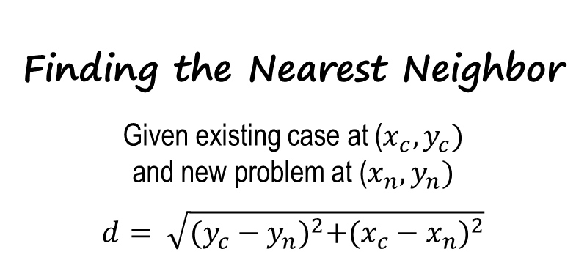
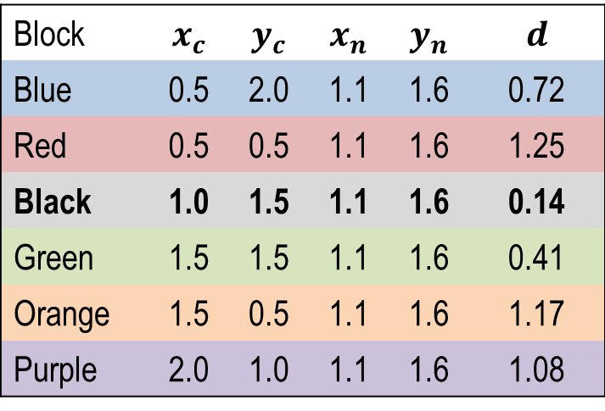
Blue
?
Black
Green
Purple
Red
Orange

Slide 6
Route | Destination_{X} | Destination_{Y}
A | 10_{E} | 8_{N}
B | 1_{E} | 8_{N}
C | 10_{E} | 4_{N}
D | 2_{E} | 1_{N}
X | 8_{E} | 2_{N}
Y | 8_{E} | 2_{N}
Z | 1_{E} | 9_{N}
Is the origin
North of 5_{N}?
Yes
No
East of 5_{E}?
East of 5_{E}?
Yes
No
Yes
No
C
East of 3_{E}?
D
B
Yes
No
X
East of 2_{E}?
Yes
No
A
Y

Slide 7
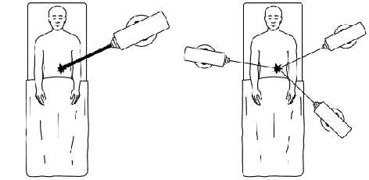

Slide 8
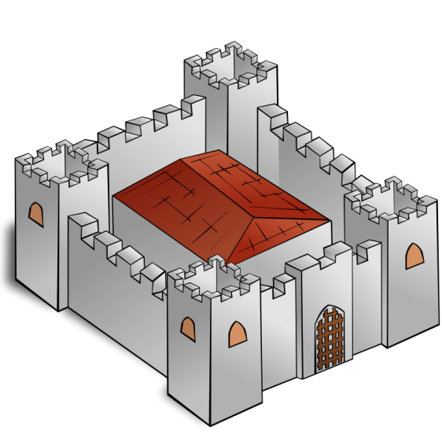




Slide 9



Slide 13
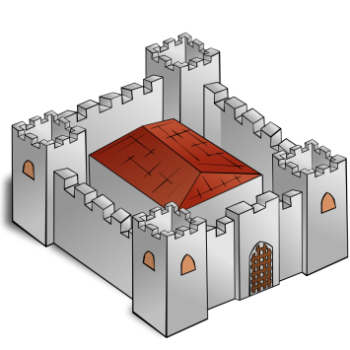


Target
Source

Slide 14
Target
Source

Slide 15
More similar
Relations? | Objects? | Features? | Values?
Similar | Similar | Similar | Similar
Similar | Similar | Similar | Dissimilar
Similar | Similar | Dissimilar | Dissimilar
Similar | Dissimilar | Dissimilar | Dissimilar
e.g. Recording Cases
e.g. Configuration
e.g. Case-Based Reasoning
e.g. Analogical Reasoning
Less similar

Slide 16
Retrieval
Mapping
Transfer
Evaluation
Storage

Slide 17
Retrieval
Retrieval
Mapping
Adaptation
Transfer
Evaluation
Evaluation
Storage
Storage

Slide 18
Route | Destination_{X} | Destination_{Y}
A | 10_{E} | 8_{N}
B | 1_{E} | 8_{N}
C | 10_{E} | 4_{N}
D | 2_{E} | 1_{N}
X | 8_{E} | 2_{N}
Y | 8_{E} | 2_{N}
Z | 1_{E} | 9_{N}
Is the origin
North of 5_{N}?
Blue
Yes
No
?
East of 5_{E}?
East of 5_{E}?
Black
Green
Yes
No
Yes
No
C
East of 3_{E}?
D
B
Purple
Yes
No
X
East of 2_{E}?
Red
Orange
Yes
No
A
Y

Slide 20
Superficial Similarity
Features
Counts
Objects
Deep Similarity
Relationships between objects
Relationships between relationships
A
B
A
B

Slide 21
Types of Similarity
Semantic
Conceptual similarity between the target problem and the source case.
Pragmatic
Similarity of external factors, such as goals.
Structural
Similarity between representational structures.

Slide 22
A woman is climbing a ladder.
Mark whether each situation has deep similarity, superficial similarity, both, or neither with the situation above.
Deep Superficial
ο ο A woman climbing a set of stairs.
ο ο An ant walking up the wall.
ο ο A woman painting a ladder.
ο ο A woman climbing the corporate ladder.
ο ο A water bottle sitting on a desk.
ο ο A woman climbing a step ladder.
ο ο A plane taking off into the sky.

Slide 23
Solar System
attracts
attracts
attracts
attracts
Atomic Structure
Nucleus
Electron
Sun
Planet
Planet
Sun
Electron
Nucleus
between
between
Force
Sun & Planet
Force
Nucleus & Electron
has
has
Sun
Mass
Planet
Mass
revolves around
revolves around
Planet
Sun
Electron
Nucleus
greater than
Sun’s Mass
Planet’s Mass

Slide 24
Solar System
attracts
attracts
attracts
attracts
Atomic Structure
Nucleus
Electron
Sun
Planet
Planet
Sun
Electron
Nucleus
between
between
Force
Sun & Planet
Force
Nucleus & Electron
has
has
Sun
Mass
Planet
Mass
revolves around
revolves around
Planet
Sun
Electron
Nucleus
greater than
Sun’s Mass
Planet’s Mass
What are the deep similarities between these two models?
ο Something revolves around something else.
ο Two things each have mass.
ο Mass & force are present.
ο A force exists between two objects.
ο The objects’ masses differ.
ο Two objects attract each other.

Slide 25
Target
Source

Slide 26
Solar System
attracts
attracts
attracts
attracts
Atomic Structure
Nucleus
Electron
Sun
Planet
Planet
Sun
Electron
Nucleus
between
between
Force
Sun & Planet
Force
Nucleus & Electron
has
has
Sun
Mass
Planet
Mass
revolves around
revolves around
Planet
Sun
Electron
Nucleus
greater than
Sun’s Mass
Planet’s Mass
How would you map the solar system to the atomic structure?
ο Sun → Nucleus
ο Electron → Nucleus
ο Nucleus → Sun
ο Sun → Planet
ο Planet → Electron
ο Planet → Sun
ο Planet → Nucleus
ο Electron → Planet
ο Sun → Electron
ο Nucleus → Planet

Slide 27
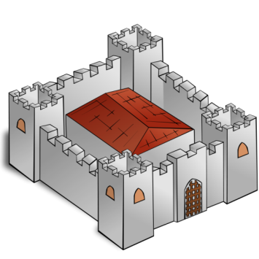


Target
Source

Slide 28
Solar System
attracts
attracts
attracts
attracts
Atomic Structure
Nucleus
Electron
Sun
Planet
Planet
Sun
Electron
Nucleus
between
between
Force
Sun & Planet
Force
Nucleus & Electron
What would be transferred into the atomic structure model?
has
has
Sun
Mass
Planet
Mass
revolves around
revolves around
Planet
Sun
Electron
Nucleus
greater than
Sun’s Mass
Planet’s Mass
ο Nucleus has mass
ο Nucleus is a sun
ο Nucleus attracts electron
ο Electron’s mass greater than nucleus’s mass
ο Electron revolves around nucleus
ο Electron has mass
ο Electrons are planets
ο Nucleus’s mass greater than electron’s mass

Slide 29
Solar System
attracts
attracts
attracts
attracts
Atomic Structure
Nucleus
Electron
Sun
Planet
Planet
Sun
Electron
Nucleus
between
between
Force
Sun & Planet
Force
Nucleus & Electron
has
has
has
has
Sun
Mass
Planet
Mass
Nucleus
Mass
Electron
Mass
revolves around
revolves around
Planet
Sun
Electron
Nucleus
greater than
greater than
Sun’s Mass
Planet’s Mass
Nucleus’s Mass
Electron’s Mass
ο Nucleus has mass
ο Nucleus is a sun
ο Nucleus attracts electron
ο Electron’s mass greater than nucleus’s mass
ο Electron revolves around nucleus
ο Electron has mass
ο Electrons are planets
ο Nucleus’s mass greater than electron’s mass

Slide 30
Retrieval
Retrieval
Mapping
Adaptation
Transfer
Evaluation
Evaluation
Storage
Storage

Slide 31
Target
Source

Slide 32
Solar System
attracts
attracts
attracts
attracts
Atomic Structure
Nucleus
Electron
Sun
Planet
Planet
Sun
Electron
Nucleus
between
between
Force
Sun & Planet
Force
Nucleus & Electron
has
has
has
has
Sun
Mass
Planet
Mass
Nucleus
Mass
Electron
Mass
revolves around
revolves around
Planet
Sun
Electron
Nucleus
greater than
greater than
Sun’s Mass
Planet’s Mass
Nucleus’s Mass
Electron’s Mass

Slide 33
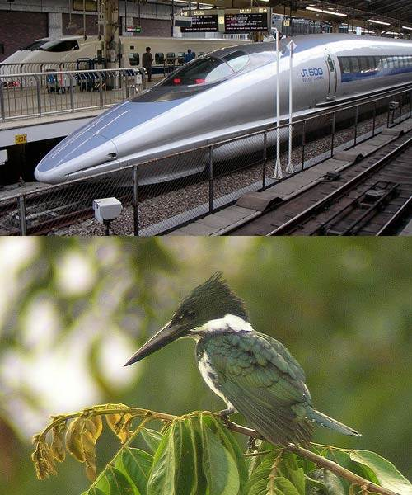
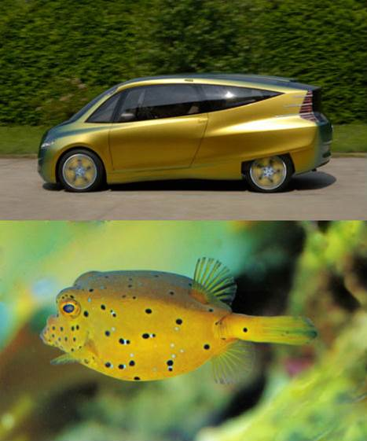

Slide 34
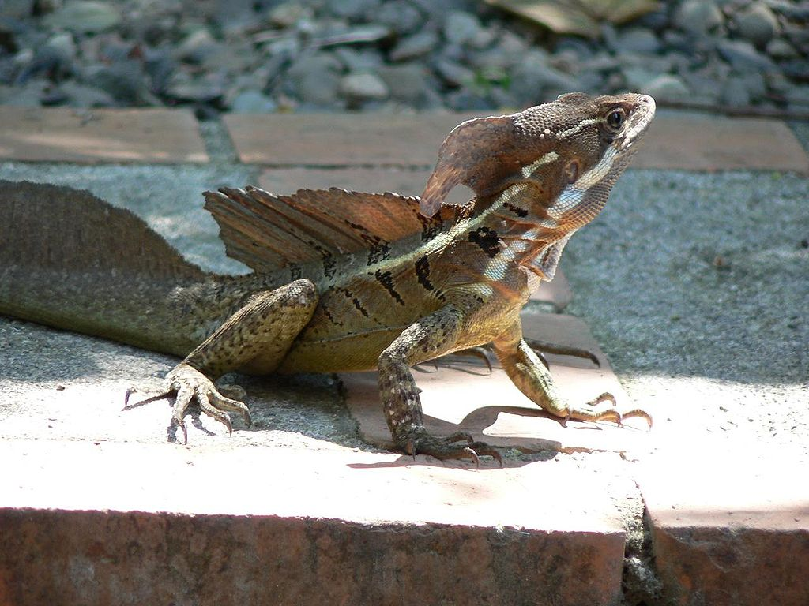
Notes:
Image credit:
"Common basilisk in Costa Rica" by The Rambling Man - Own work. Licensed under Creative Commons Attribution-Share Alike 3.0 via Wikimedia Commons - https://commons.wikimedia.org/wiki/File:Common_basilisk_in_Costa_Rica.jpg#mediaviewer/File:Common_basilisk_in_Costa_Rica.jpg

Slide 35
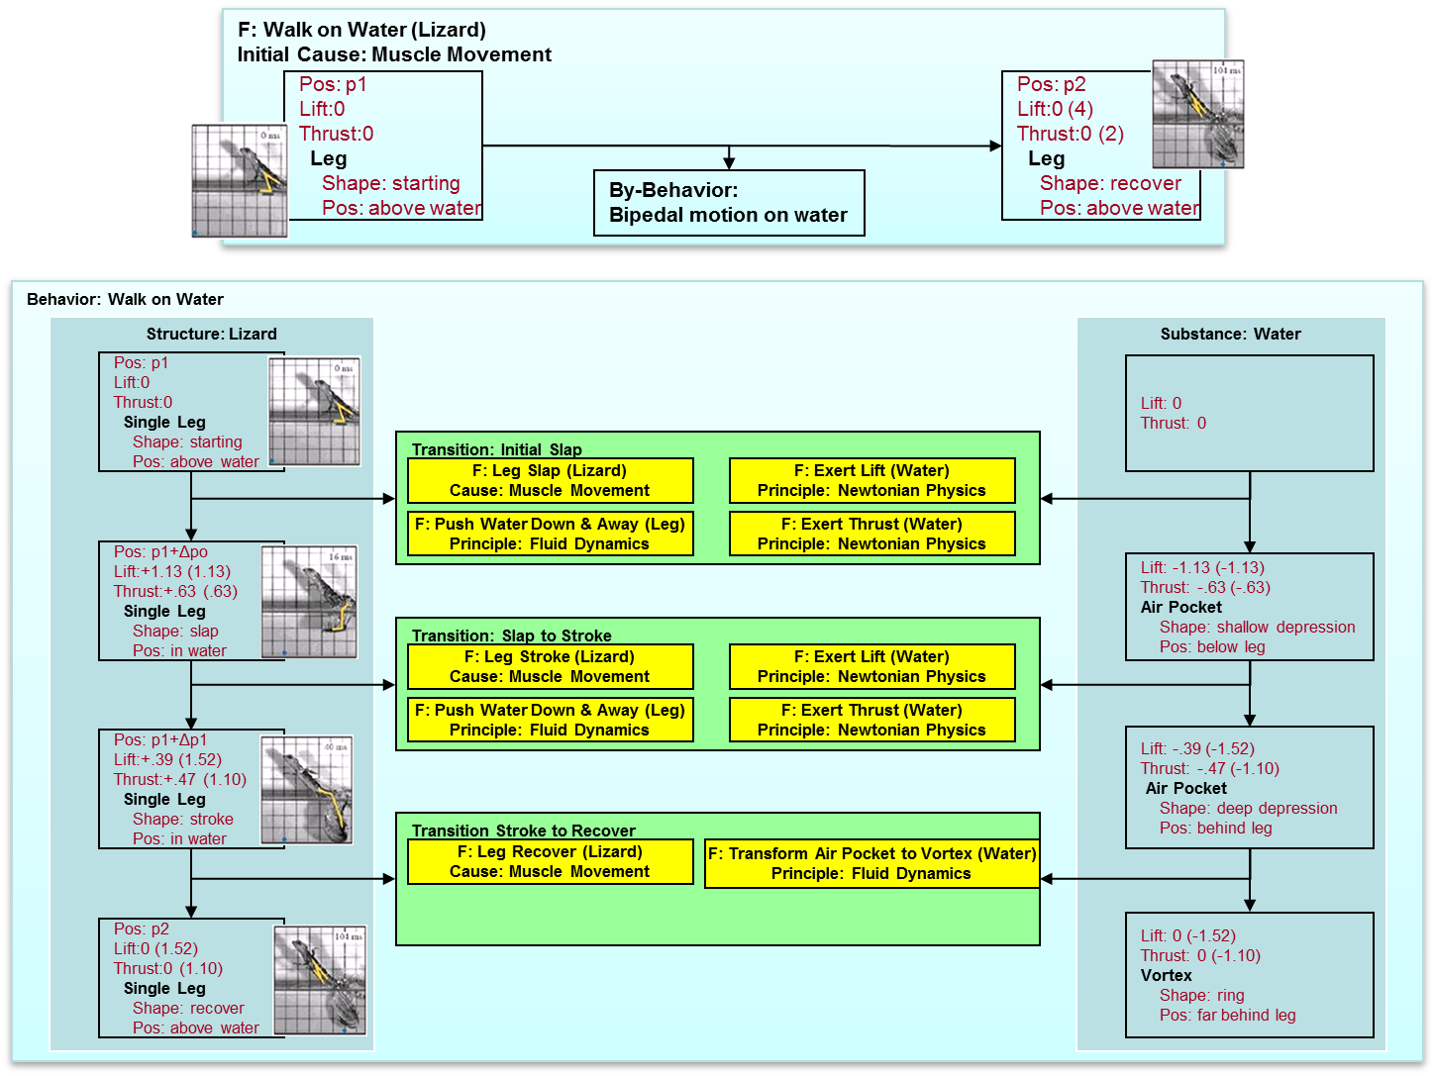

Slide 36

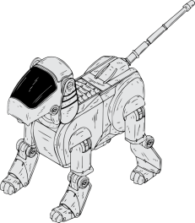
Structure Model
Structure Model
Behavior Model
Behavior Model
dsacacsacdscdscsaca
dsacacsacdscdscsaca
dsacacsacdscdscsaca
dsacacsacdscdscsaca
dsacacsacdscdscsaca
dsacacsacdscdscsaca
dsacacsacdscdscsaca
dsacacsacdscdscsaca
dsacacsacdscdscsaca
dsacacsacdscdscsaca
Function Model
Function Model
Size : large
State : small
Placement : left
Orientatin : right
Rotation : 90
Color : Blue
Thickness : thin
Species : cat
Age : 5
Weight : 54
Height : 43
Size : large
State : small
Placement : left
Orientatin : right
Rotation : 90
Color : Blue
Thickness : thin
Species : cat
Age : 5
Weight : 54
Height : 43
Size : large
State : small
Placement : left
Orientatin : right
Rotation : 90
Color : Blue
Thickness : thin
Species : cat
Age : 5
Weight : 54
Height : 43
Size : large
State : small
Placement : left
Orientatin : right
Rotation : 90
Color : Blue
Thickness : thin
Species : cat
Age : 5
Weight : 54
Height : 43

Slide 37
Retrieval
Mapping
Transfer
Evaluation
Storage

Slide 38
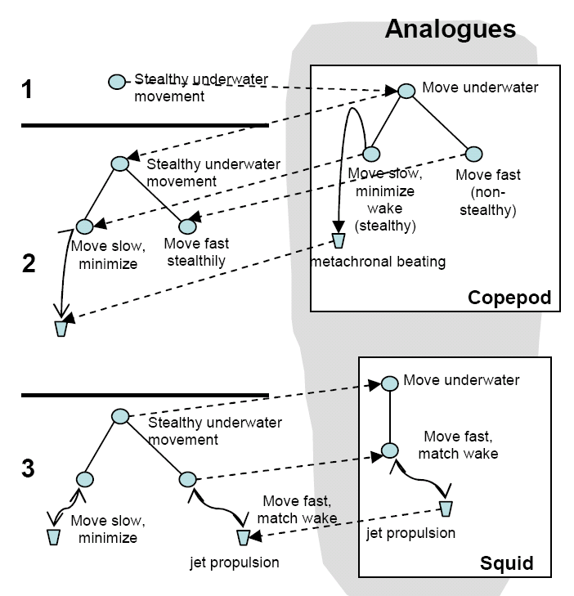
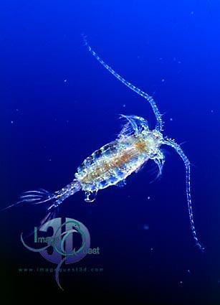
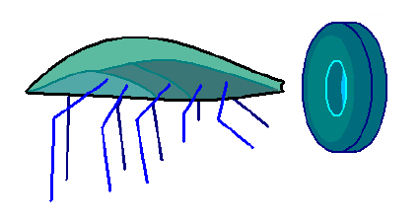
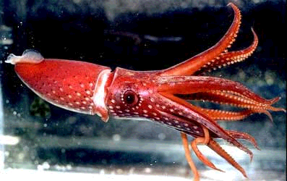

Slide 39
Retrieval
Mapping
Transfer
Evaluation
Storage

Slide 40
Retrieval
Mapping
Transfer
Evaluation
Storage

Slide 41
Retrieval
Mapping
Transfer
Evaluation
Storage

Slide 42
Advanced questions in analogical reasoning
Common vocabulary
Abstraction and transformation
Compound and compositional analogies
Visuospatial analogies
Conceptual combination

Slide 43
Assignment
How would you use analogical reasoning to design an agent that could answer Raven’s progressive matrices?

Slide 44
To recap…
Similarity
Analogical retrieval
Analogical mapping
Analogical transfer
Evaluation and storage
Design by analogy

